Slide 1
Operating System UNIX & Linux
Programme – T.Y.BBA(CA)
Subject title - Operating System UNIX & Linux (Revised 2017 Pattern)
Subject code-4604 Semester - VI Credit – 4
By
Deepali Bhoskar

Slide 2
History of Unix System Structure User perspective Operating system Services Assumptions about Hardware
Unit 1 Introduction to Operating Systems General Overview:

Slide 3
General overview of the system
Benefits of Unix
The system is written in high level language “C” which makes it easier to read understand and update. It off-course is little slower in comparison to what written in assembly language but the advantages are far greater and possibilities are endless.
Complex programs can be built on simple programs on unix systems.
It has hierarchal file system which allows easy maintenance and efficient implementation.
It has consistent format for files. The files are stored as byte streams which makes it easier for the programs to use files.
It provides simple and consistent interface to the peripheral devices.
It completely hides the machine architecture from the user which makes it easier for the programmers to write programs independent of hardware.

Slide 4
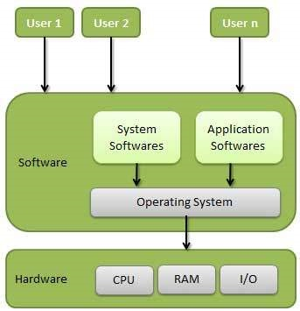
What is an Operating System?
Definition
An operating system is a program that acts as an interface between the user and the computer hardware and controls the execution of all kinds of programs.

Slide 5
What is an Operating System?
The operating system (OS) is the program which starts up when you turn on your computer and runs underneath all other programs - without it nothing would happen at all.
In simple terms, an operating system is a manager. It manages all the available resources on a computer, from the CPU, to memory, to hard disk accesses.
Tasks the operating system must perform:
Control Hardware - The operating system controls all the parts of the computer and attempts to get everything working together.
Run Applications - Another job the OS does is run application software. This would include word processors, web browsers, games, etc...
Manage Data and Files - The OS makes it easy for you to organize your computer. Through the OS you are able to do a number of things to data, including copy, move, delete, and rename it. This makes it much easier to find and organize what you have.

Slide 6
UNIX History
The UNIX operating system was born in the late 1960s. It originally began as a one man project led by Ken Thompson of Bell Labs, and has since grown to become the most widely used operating system.
In the time since UNIX was first developed, it has gone through many different generations and even mutations.
Some differ substantially from the original version, like Berkeley Software Distribution (BSD) or Linux.
Others, still contain major portions that are based on the original source code.
An interesting and rather up-to-date timeline of these variations of UNIX can be found at
http://www.levenez.com/unix/history.html.

Slide 7
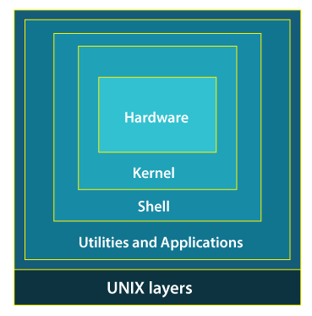
System Structure

Slide 8
System Structure
While working with UNIX OS, several layers of this system provide interaction between the pc hardware and the user.
Layer-1: Hardware -
This layer of UNIX consists of all hardware-related information in the UNIX environment.
Layer-2: Kernel -
The core of the operating system that's liable for maintaining the full functionality is named the kernel.
The kernel of UNIX runs on the particular machine hardware and interacts with the hardware effectively.

Slide 9
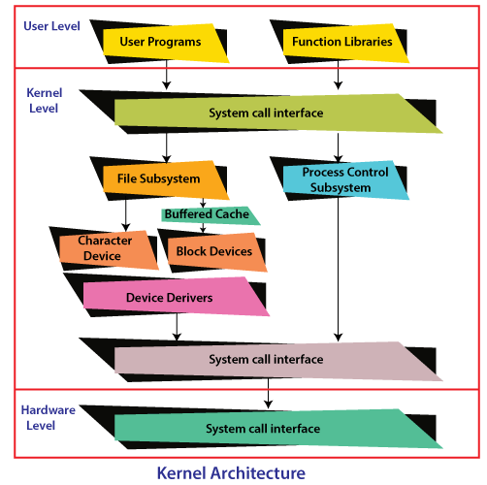
System Structure

Slide 10
System Structure
It also works as a device manager and performs valuable functions for the processes which require access to the peripheral devices connected to the computer. The kernel controls these devices through device drivers.
The kernel also manages the memory. Processes are executed programs that have owner's humans or systems who initiate their execution.
The system must provide all processes with access to an adequate amount of memory, and a few processes require a lot of it.
To make effective use of main memory and to allocate a sufficient amount of memory to every process.
It uses essential techniques like paging, swapping, and virtual storage.

Slide 11
System Structure
Layer-3: The Shell -
The Shell is an interpreter that interprets the command submitted by the user at the terminal, and calls the program you simply want.
It also keeps a history of the list of the commands you have typed in. If you need to repeat a command you typed it, use the cursor keys to scroll up and down the list or type history for a list of previous commands. There are various commands like cat, mv, cat, grep, id, wc, and many more.
Layer-4: Application Programs Layer -
It is the outermost layer that executes the given external applications. UNIX distributions typically come with several useful applications programs as standard.
For Example: emacs editor, StarOffice, xv image viewer, g++ compiler etc.

Slide 12
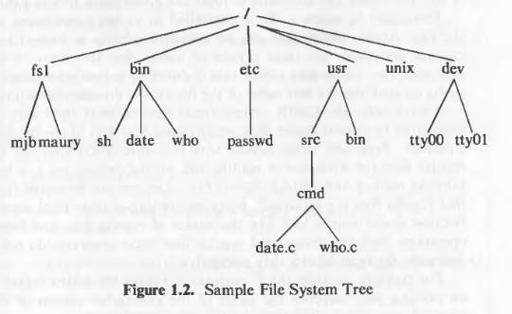
User perspective:The file system

Slide 13
User perspective:The file system
The characteristics of unix file system are
A hierarchal structure.
Consistent treatment of data
Ability to create and delete files
Dynamic growth of files
Peripheral devices are also treated as files
The file system is organized as a tree. The root node is called “root” and is denoted by “/”. Every non leaf node in this structure is a directory and every leaf node is a file/special device file.
The name of the file is given by the path name.

Slide 14
User perspective:The file system
A full path name starts with the root directory i.e. a slash character and specifies the file that can be found by travestying the tree. Some examples of paths could be “/etc/passwd”, “/bin/who” and “/usr/src/programs/test.c”.
The path that starts from the root directory is called the absolute path. Alternatively we can give path of any file relative to any other directory. This path will be called relative path.
The files are just stream of bytes it is up-to the program to interpret these bytes. Directories are also files i.e. a stream of bytes but the operating system program knows how to interpret them as directories. Example program could be “ls”
Permission to any file is governed by the file access permissions. Access permissions are set independently for read, write and execute. These permissions are set independently for the file owner, file group and everyone else. Access permission looks like
rwx-rwx-rwx (We will see more of this in later chapters)
Unix treats devices as if they are files. Every device is treated as special files and occupy position in the file system. Programs can access devices using the same syntax as if they were accessing files. Syntax of reading and writing on devices is more or less same as reading and writing regular files. Devices are protected in the same way as files i.e. using access pemissions.

Slide 15
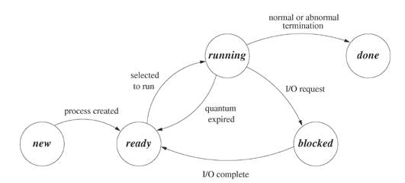
User perspective: Processing environment

Slide 16
User perspective: Processing environment
A source code is our program source code, an executable file is the program for our source code and the process is the instance of our program in execution. Many processes can execute simultaneously in unix. (Multiprogramming or multitasking).
Also many instances of one program can run simultaneously. Each instance of this program is one process. Various system calls allows control of the state of the process. The state of a process indicates its status at a particular time. The process state could by any one of the above.

Slide 17
User perspective: Processing environment
Process state information along with other useful information is stored in a process control block. Every process has its own process control block or PCB. Unix shell allows three types of commands.
An executable file created by compilation of our source code.
An executable command that contains a sequence of shell commands.
An internal shell command.
The shell, usually, run the commands synchronously. However these commands can also be run asynchronously.

Slide 18
User perspective: Building block primitives
Unix allows user to write small programs, in a modular way. These programs can be used as building blocks to build the complex programs. Unix has three standard files:
Standard input file
Standard output file
Standard error file
Typically when we run shell our terminal (monitor) is serving as these three files. (remember devices can be treated as files).
One primitive building block available to the shell user is the redirect I/O. for example ls
this command list down all the files in the current directory. ls > output
this command will send this list of files to a file named “output” instead of the terminal.
The second building block primitive is the PIPE. Pipe allows a stream of data to be passed from processes. There is one reader process and one writer process.
ls | more

Slide 19
Operating system Services
The kernel layer provides various operations on behalf of user processes. Some of the main services provided by the operating systems kernel are:
Process control: controlling the creating, termination and suspension of processes.
Scheduling processes: Since many programs can execute simultaneously in unix the process scheduling is also done by the kernel.
Main memory management: allocating main memory to the user programs and protecting the memory region where kernel is running. Also, protecting the memory region of one process from another process.
Virtual memory: managing the swap device and handling the swapping system. Controlling the pages in the paging system(memory allocation)
Secondary memory management: Managing the secondary storage for the efficient and timely retrieval and storage of data.
Peripheral devices: kernel controls the peripheral devices such as terminals, disk drives and network devices.

Slide 20
Assumptions about the hardware
When a process executes on unix it executes on two levels or we can say it executes in two modes.
User level
Kernel level
Processes in user mode can assess their own instructions but not the kernel instructions or the instruction of other processes. On the other hand processes in kernel mode can access kernel data and instructions as well as user data and instructions.
The system calls can only be executed in the kernel mode. If a user process running in user mode make a system calls the process shifts from user mode to kernel mode and then the kernel services the request and the system comes back to the user mode after the request is serviced.

